Slide 1
Group 9 project presentation
Study track
Ishmaiah Etienne-Scrum master
Juan Molina-product owner
Lucas Dizengoff-development
Youtham Indraws-development
Url: https://team-9-bf600.web.app/

Slide 2
Project's market focus
The purpose of the project it to provide a simple management system for academic reports and data for teachers, students, parents and other staff
The systems functions is to allow some user a tool to be able to create reports, add key data to fill in the report, and to view saved reports
We were interested in creating this project from the experiences with using other programs

Slide 3
Systems infrastructure
We are basing the project in a layered online webpage using html and CSS with java
A database with user data
We wanted the webpage to be accessible in the main online browsers , chrome, Firefox, safari and edge

Slide 4
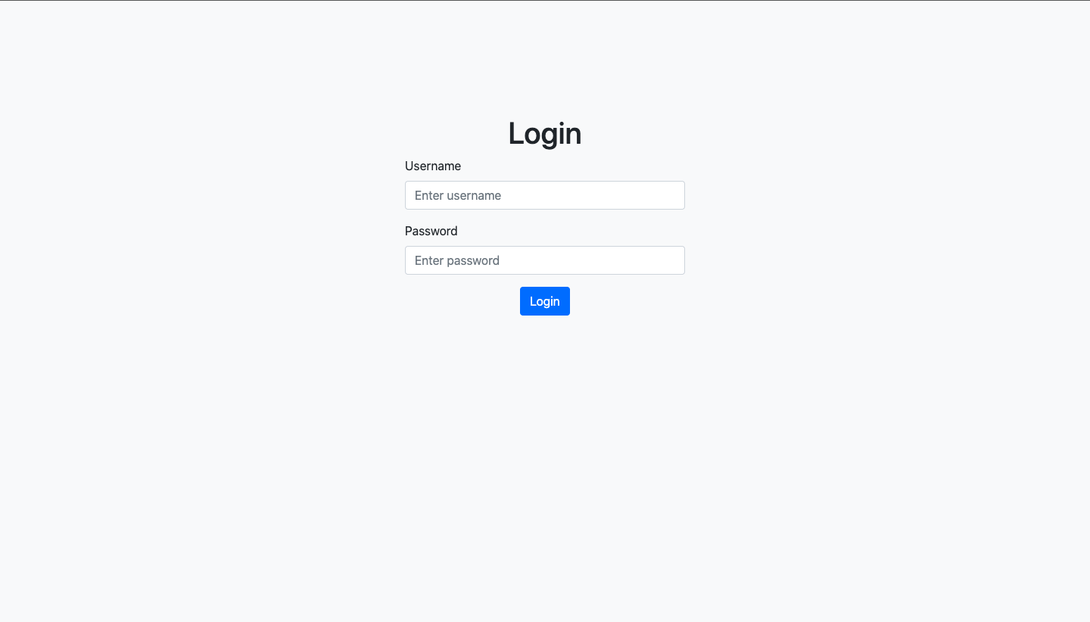
Login Page

Slide 5
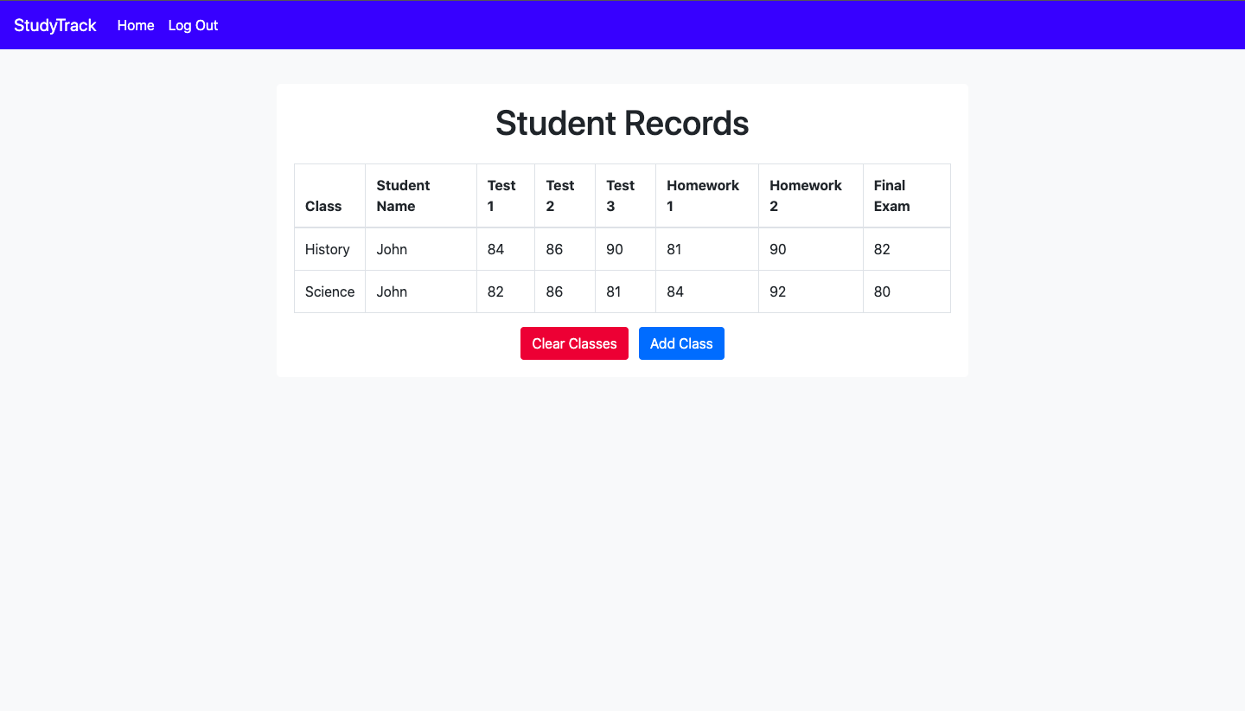
Student Records Page

Slide 6
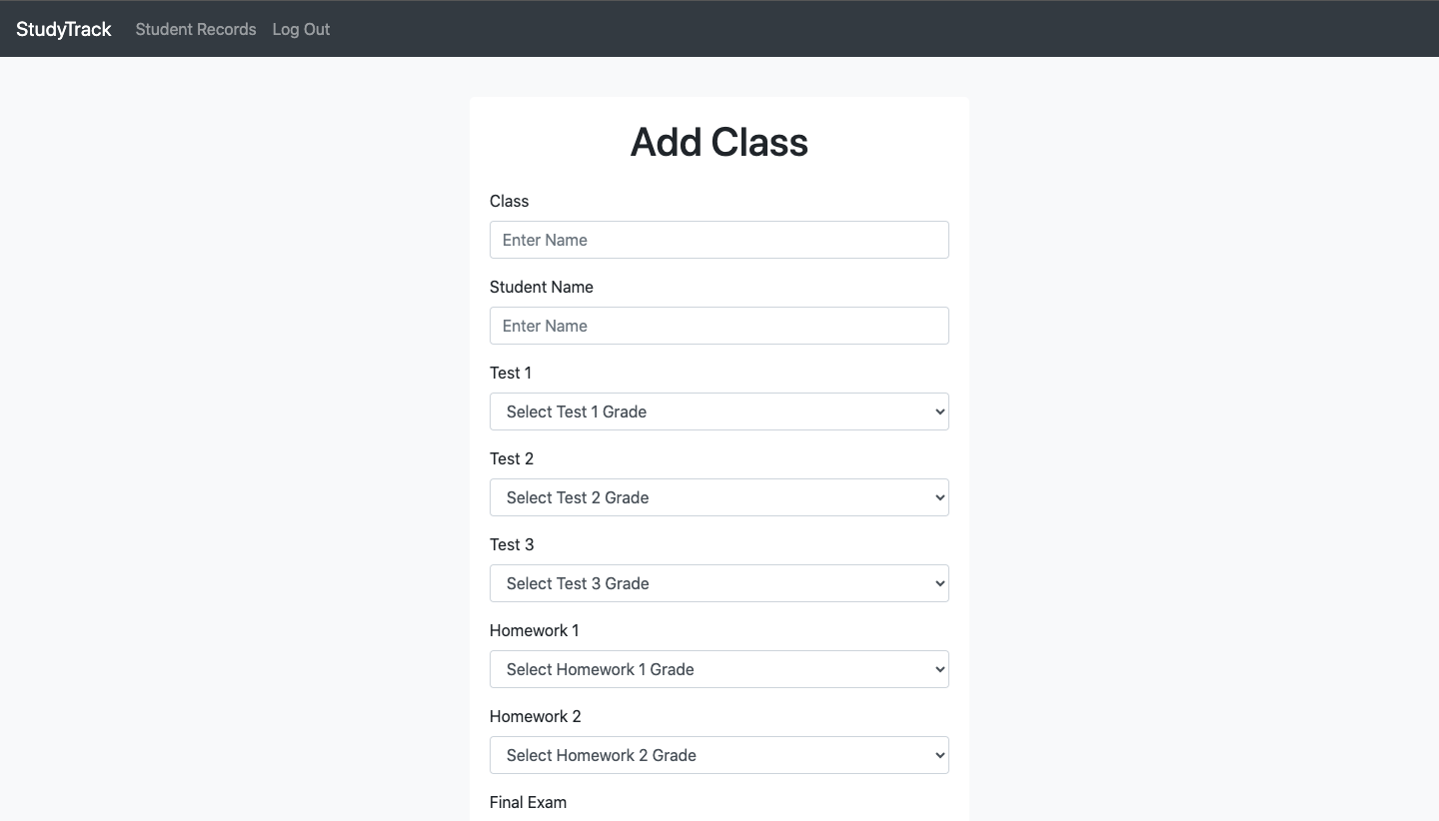
Student Grades Input Page

Slide 7
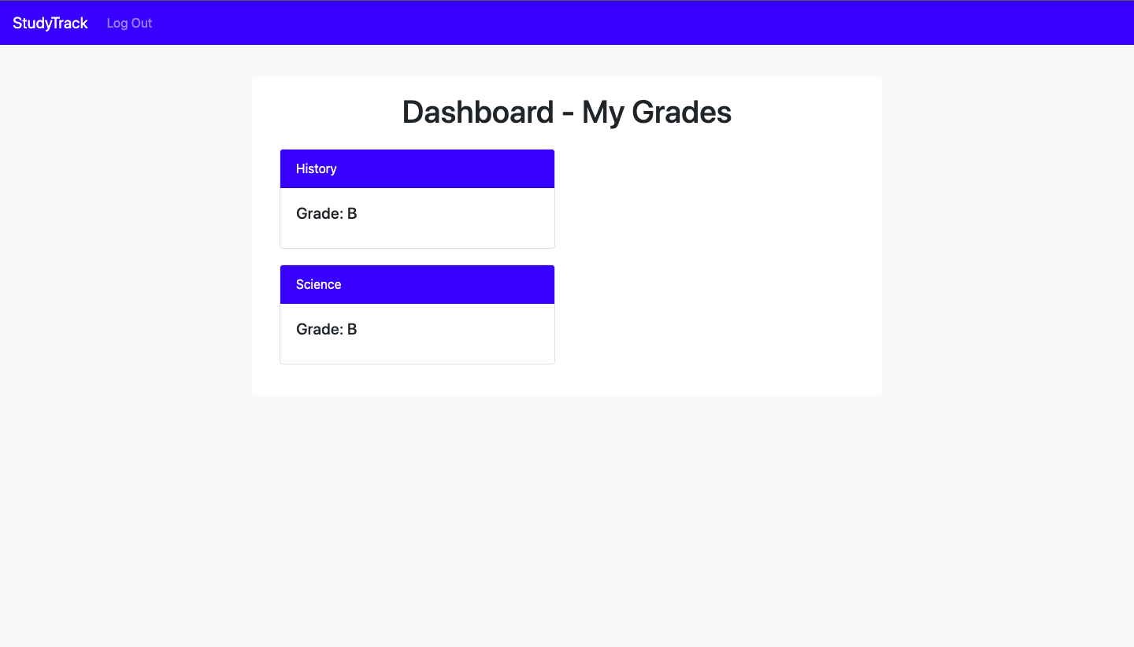
View Student Class Grades

Slide 8
Nonfunctional system requirements
Usability: The system should be easy to navigate and use for administrators and teachers.
Security Requirements: The system should have secure login and password management to prevent unauthorized access.
Availability: The system should be available 24/7
Performance: The system should load quickly for better experience for users.
Scalability: The system should be able to hold an increase in user base without a decrease in system performance.
Compatibility: System should be accessible on multiple different web browsers.

Slide 9
Finished features
Grade input
Grade Access for student
Login Page
Student report Page

Slide 10
Future features
Ability to print out reports, Account registration, Better site Design.
Cause: Lack of Web Development Experience and time

Slide 11
Knowledge Gained/ Lessons Learned
Further Understanding of Web Development
Better Time management
Better Communication throughout team
Project planning

Slide 12
Q&A
We will try to add more features/ update others to work more efferently
The webpage will be updated with a new design if needed
Will work on providing more systems access to the program
Priority will be on keeping the system running and useable to active users and will extend service hours

